Slide 1
Probe Data Analysis for Road Slope
Assignment 2
CS – 513
Geospatial Vision / Visualisation
Submitted By:
Adarsh M V – A20424847
Harshitha Rangaswamy – A20400223
Prerna Kumari – A20428292
Rahul Hosmani – A20418527

Slide 2
Index
Content | Slide Number
Assignment 2 | 3
Understanding about the Probe data | 4
Understanding about the Map Matching | 5
Approaches | 6
Matching Probe data to appropriate link | 9
Formulas Used | 10
Structure of our Assignment | 12
Working Flow of Our Assignment | 13
Slope Approach | 16
Results / Outputs | 18
References | 21

Slide 3
Assignment 2
Input:
Probe data which includes:
Raw probe points from part of the Germany collected in 9 months
Link data for links that probe points can be map matched to
Task:
Map-Matched probe points to road links
Derive road slope for each road link
Evaluate the derived road slope with surveyed road slope in link data file

Slide 4
Understanding about the Probe data
Data that is generated by monitoring the position of individual moving objects (i.e., probes) over space and time
Moving objects: vehicles (cars, buses, trains, bikes, ships, etc.), pedestrians
Data for each probe is a time series of locations (x1, y1, t1), (x2, y2, t2), …
Other common attributes: probe id, speed, heading
Probe data is an emerging source of information on transport demand patterns and performance of the transport network
Probe data is useful in many ways:
Determine traffic speeds or travel time of road segments
For transportation planning
Map refinement/Creation
Intersection delay analysis

Slide 5
Understanding about the Map Matching
Map matching is performed by obtaining probe data and thus mapping it to the map using the given information like latitude, longitude, timestamp, elevation etc.
It helps in identifying inaccuracy of positioning, off the road locations, error of a GPS point etc. The error of GPS point is corrected by snapping the GPS point onto the road network.
Map-matching algorithm integrate probe data with road link data to identify the correct link on which a vehicle is travelling and to determine the location of vehicle on a link.
There are several algorithms present to perform map-matching which are:
Probabilistic theory
Kalman filter
Fuzzy logic etc.

Slide 6
First Approach
Our initial approach was:
Draw links using the link data provided and try to plot the probe data on the link and find the matched points and find slope and distance
But this approach was wrong because the probe data will not be exactly on the link and so we are not able to proceed further

Slide 7
Second Approach
In this we assumed that we need to find a threshold, or region within which if the probe data is located form the link we can consider them.
And for finding the shortest path we can use any shortest path algorithm.
But in this method we are not able to complete or conclude as we already have distance given in link data so we don’t require any shortest path algorithm.

Slide 8
Final Approach
We referred to this paper - Map-Matching for Low Sampling Rate GPS Trajectories - http://infolab.usc.edu/csci587/Fall2016/papers/Map-Matching%20for%20Low-Sampling-Rate%20GPS%20Trajectories.pdf - in implementing our assignment.
According to this approach we made a region to track the next point.
Using probe point location checked they are in the region to connect with the link.
And calculated the distance and slope using the matched points we obtained.
In the following slides we will explain the logic we used in this approach.

Slide 9
Matching the probe point to appropriate link
Steps followed in our approach:
Consider a probe point at a time.
Iterate this point within all given links to find the link which has minimum distance from probe.
To find the distance between link and probe, find the midpoint of the link. Find the distance from this midpoint to probe point.
Store this distance as minimum distance.
Following the above 2 steps through out the iteration and if a distance is found whose value is less than pre stored minimum distance then substitute minimum distance with new distance.
Link for which the minimum distance obtained is the link to which that particular probe point belongs to.

Slide 10
Formulas Used: To find the midpoint between 2 geospatial points
Midpoint Formula using midpoint of a great circle from Chris Veness’s geodesy formula:
x_lat, x_lon = radians(lattitude1), radians(longitude1)
y_lat, y_lon = radians(lattitude2), radians(longitude2)
delta_lon = y_lon - x_lon
x = cos(b_lat) * cos(delta_lon)
y = cos(b_lat) * sin(delta_lon)
lat = atan2( sin(x_lat) + sin(y_lat),sqrt(((cos(x_lat) + x)**2 + y**2)) )
lon = x_lon + atan2(y, cos(x_lat) + x)
lon = (lon + 3*pi) % (2*pi) - pi
midpoint = Point(latitude=degrees(lat), longitude=degrees(lon))
Where Point is a function imported from geopy.point package in python 2.7

Slide 11
Formulas Used cont.
Haversine Formula: It determines the great-circle distance between two points on a sphere given their longitudes and latitudes.
a = sin²(Δφ/2) + cos φ₁ ⋅ cos φ₂ ⋅ sin²(Δλ/2)
c = 2 ⋅ asin( √a )
R = 6371*1000
Where a = square of half of the chord length between the points
c = angular distance in radians
R = radius of Earth in km
φ = latitude in radians
λ = longitude in radians

Slide 12
Structure of Our Assignment
We structured our assignment which has the below mentioned python files in the order mentioned here:
The main program file to run is MatchingProbeData.py, which imports the files
- ProbeInfo.py
- MapInfo.py, which imports the file
- LinkInfo.py.
The intermediate result file Partition6467MatchedPoints.csv is created which contains the probe points that were matched to the link data.
The final result file Partition6467SlopeValues.csv is created which has the slopes calculated

Slide 13
Working Flow of Our Assignment
The working approach we followed in our assignment is as follows:
Partition6467linkdata.csv file is read using MatchingProbeData.py file
The data is read by using open() and reader() functions
Data is fetched in the columns and assigned to respective variables
The function obtain_probeInfo() is used to read data from file Partition6467Probepoints.csv
After the values are fetched in respective variables the distance is calculated to perform map match.
The formulas used for calculating distance are as detailed in the previous slides

Slide 14
Working Flow cont…
Haversine function in python file is then called to compute the distance from reference and then from probe data the fetched latitude and longitude are passed to the distance function to compute the distance.
Latitude and longitude are fetched from probe points, to compute the distance to latitude and longitude of every node in the link.
Minimum distance is then calculated using fetchClosest_connection function. This calculated distance is then used to determine the point map-matched with the link.
If the link distance is less than minimum distance for any link then the point is matched to that link.
The result obtained from above task is saved in Partition6467MatchedPoints.csv file.

Slide 15
Working Flow cont…
Calculating the Slope
To calculate the slope, altitude is used from the probe data. Then hypotenuse is calculated using haversine function. Once both the values are obtained, slope is then calculated
Derived Slope = altitude/hypotenuse
The output is displayed on the console when ‘MatchingProbeData.py’ is executed
To evaluate derived road slope with surveyed slope in link data file following tasks are performed:
If the slope is less than 1 or it is less than -1, distance is then printed between the probes.
If the surveyed slope information is not available, derived slope is then printed along with the statement ‘Surveyed slope: N/A’.
If probe points are same ‘X’ is then printed as slope cannot be calculated for such probe points.
If after calculating road slope for each road link, if surveyed information is available both of them are printed in console.
Result of the above task is printed on the console

Slide 16
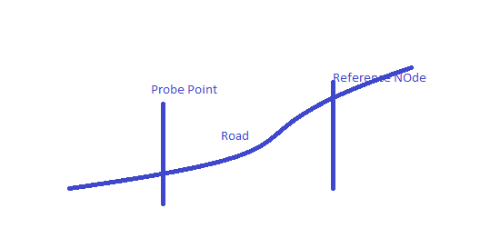
Slope Approach
The image shows an example of the slope between the reference and Probe point, By levelling we can find the difference between the probe and reference node also difference in the height.

Slide 17
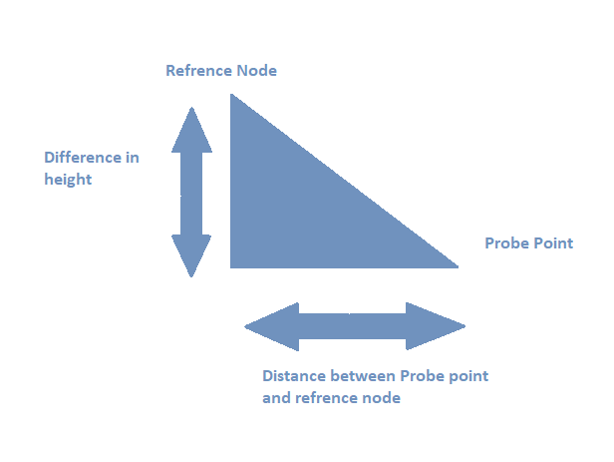
Slope Calculation
The Slope calculation is picturized as shown, by using the approach shown in the previous slide

Slide 18
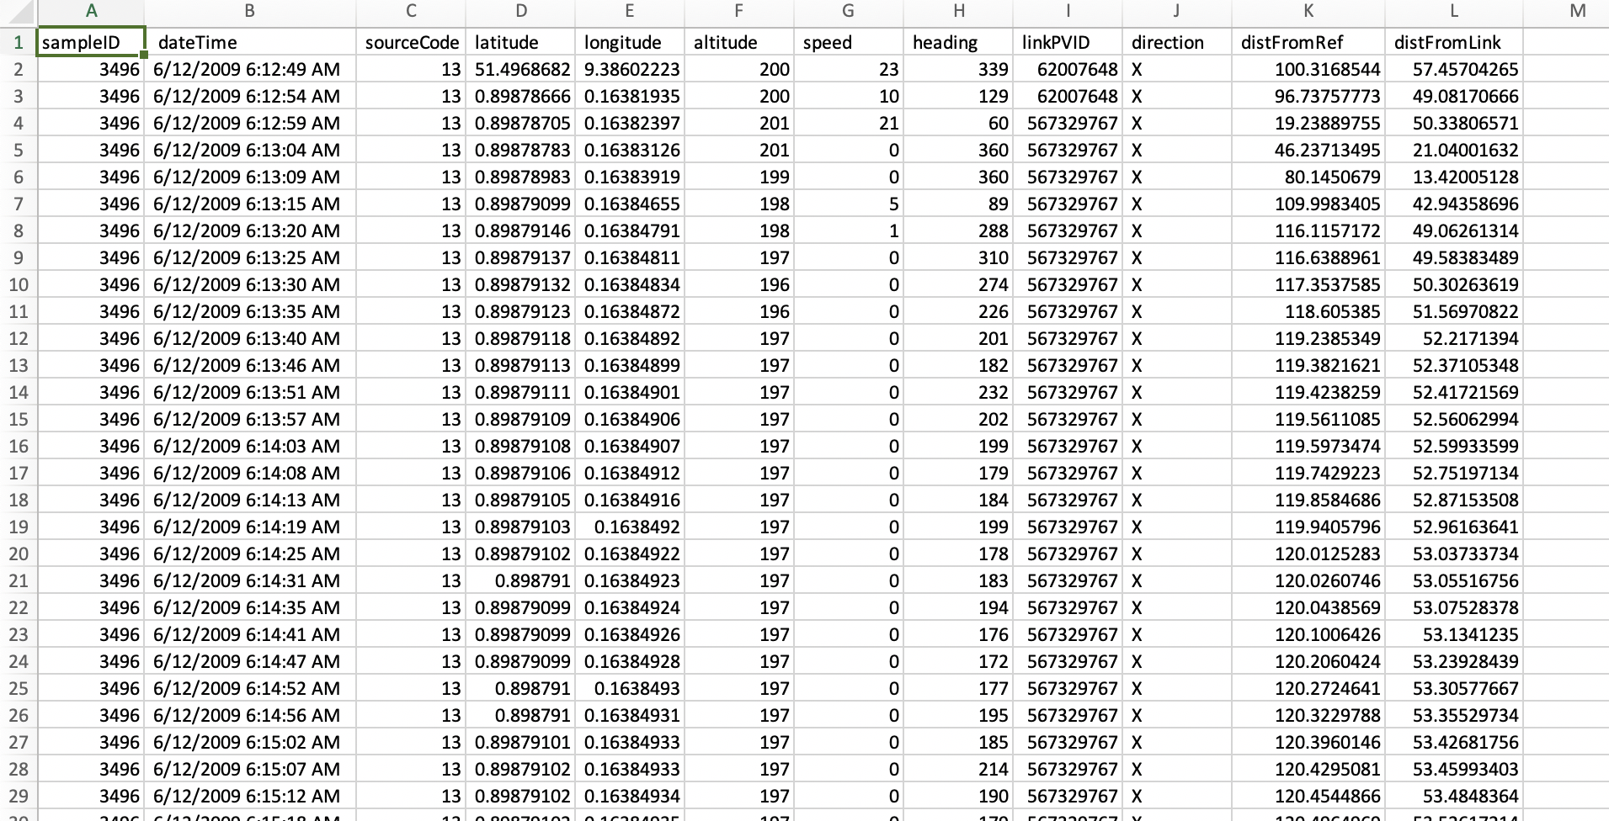
Intermediate Result File
The intermediate result file Partition6467MatchedPoints.csv is created which contains the probe points that were matched to the link data.

Slide 19
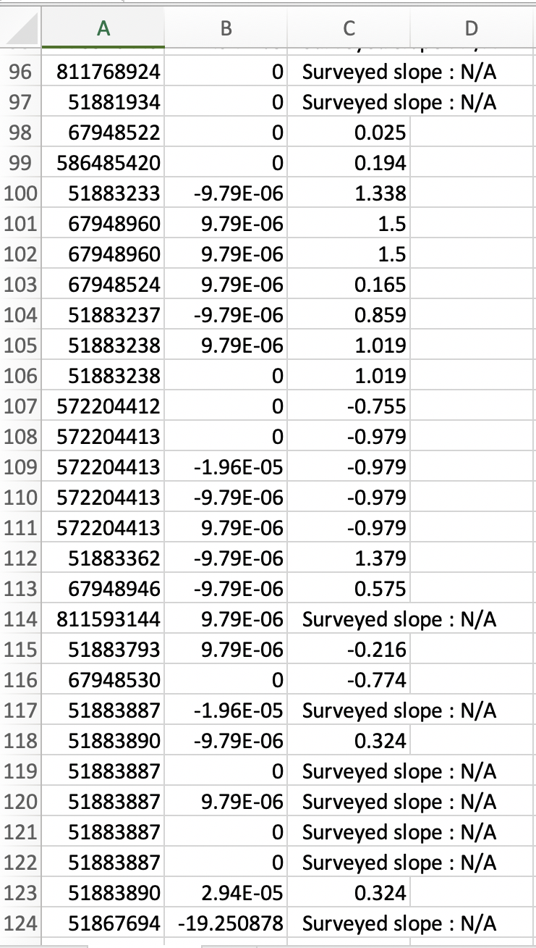
Final Result File
Format of SlopeValues.csv
linkPVID, derivedSlope, surveyedSlope
linkPVID is a unique identifier for a link.
derivedSlope is the slope calculated for a probe point.
surveyedSlope is the slope for a specific link.
The final result file Partition6467SlopeValues.csv is created which has the slopes calculated

Slide 20
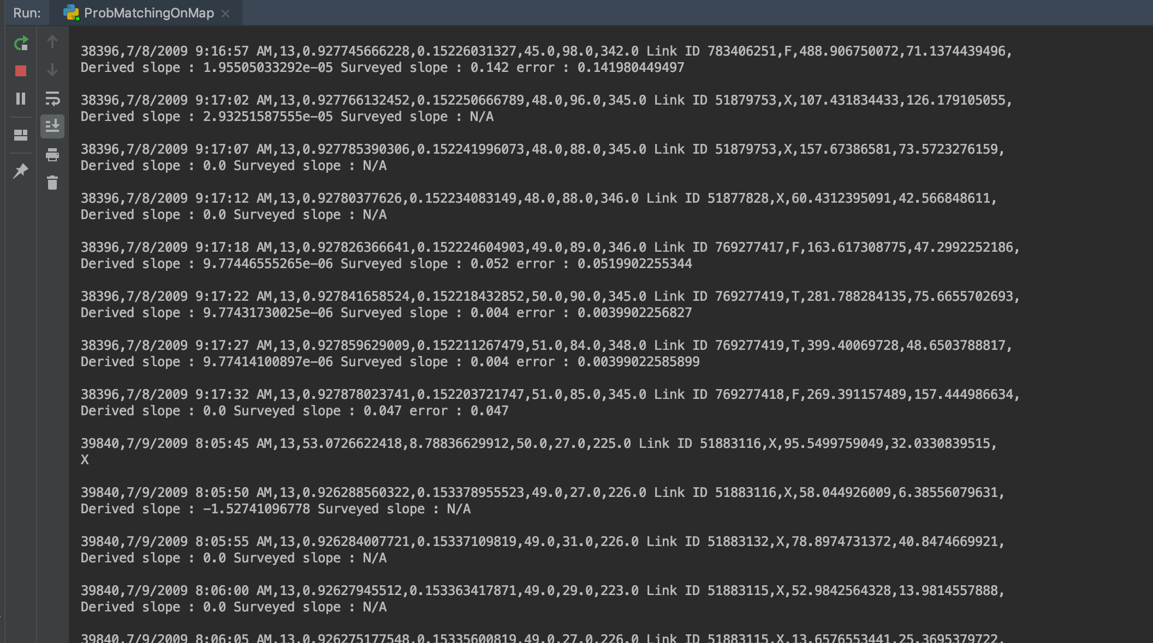
Output in the Console
The calculated slope and the Surveyed slope are printed to the console output.

Slide 21
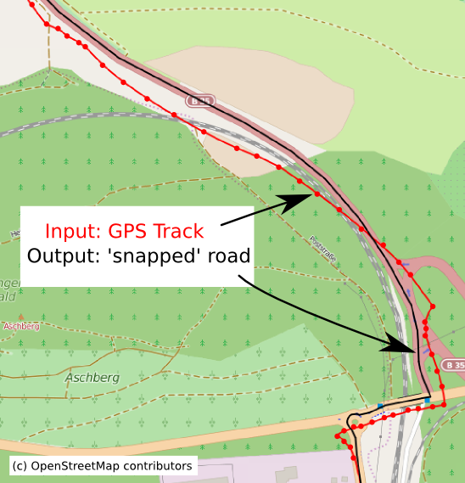
Map Matching
The final result of map matching in actuality would be as picturized here.
The raw probe points trajectory is depicted in red line.
The actual road link to which these probe points are matched to is depicted in black line.

Slide 22
References
https://infolab.usc.edu/csci587/Fall2016/papers/Map-Matching%20for%20Low-Sampling-Rate%20GPS%20Trajectories.pdf
https://www.movable-type.co.uk/scripts/latlong.html
http://web.mit.edu/jaillet/www/general/map_matching_itsc2012-final.pdf
https://blog.mapbox.com/matching-gps-traces-to-a-map-73730197d0e2
https://www.researchgate.net/publication/226834033_An_off-line_map-matching_algorithm_for_incomplete_map_databases

